Slide 1

Sprocket Central Pty Ltd
Data analytics approach
Asya Ahmed

Slide 2
Agenda
Introduction
Data Exploration
Model Development
Interpretation

Slide 3
Introduction
Identify & Recommend High value customers
Outline of problem
Data analysis approach
Sprocket Central Pty Ltd is a company that specializes in high-quality bikes and accessible cycling accessories to riders.
Their marketing team is looking to boost business by analyzing their existing customer dataset to determine customer trends and behavior.
Using the existing 3 datasets (Customer demographic, customer address and transactions) as a labelled dataset, please recommend which of these 1000 new customers should be targeted to drive the most value for the organization.
New and old customer age distributions.
Bike related purchase over the last three years based on gender.
Top job industries contributing high profit and bike related sales.
Wealth segmentation by age category.
Number of cars owned in each state.
RFM analysis and customer segmentation.

Slide 4
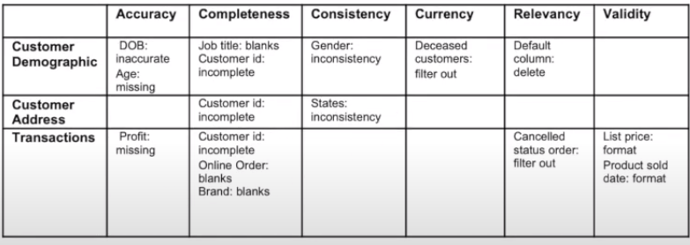
Data Exploration
Data Quality Assessment & Clean Up
Data quality dimensions to assess
Summary Table
Accuracy : How well does a piece of information reflect reality?
Completeness: The values free from missing values
Consistency: Does information stored in one place match relevant data stored elsewhere?
Currency: values up to date.
Relevancy: Data items with value Meta-data
Validity: Is information in a specific format, does it follow business rules, or is it in an unusable format?
Uniqueness : Records that are not duplicated.

Slide 5
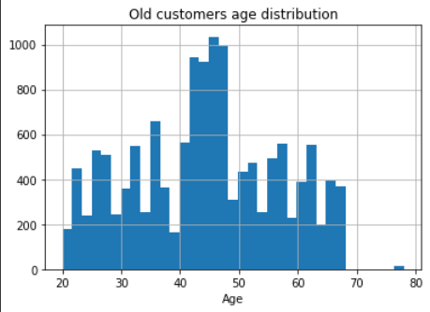
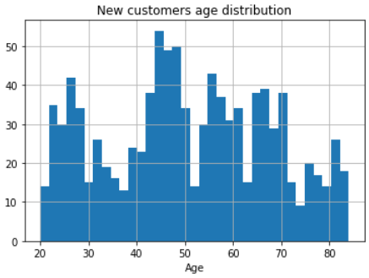
Data Exploration
New and old customer age distributions
In both new and old customer data, the majority of customers are in aged between 40-49.
The lowest age groups are under 20 and 80+ for both new and old customers data.
There is a steep drop of customers in the 30-39 age group in new.

Slide 6
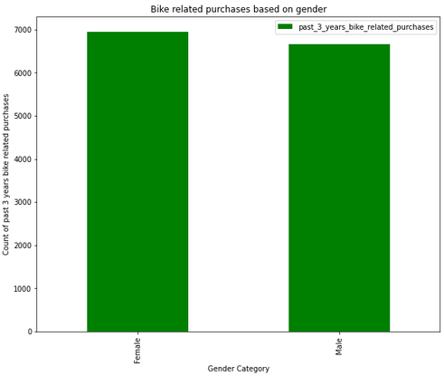
Data Exploration
Bike related purchase over the last three years based on gender.
Over the last three years females have made more bike related purchase compared to males.
Females make up the majority of bike related sales

Slide 7
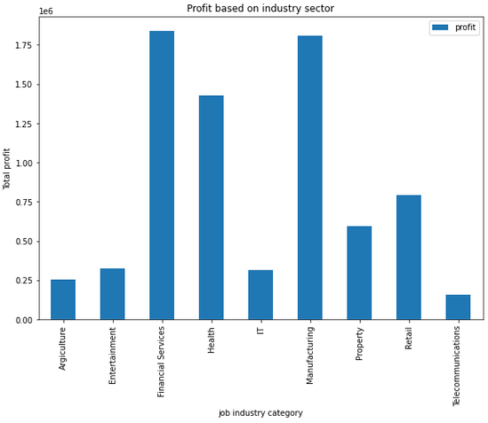
Data Exploration
Top job industry contributing high profit & bike related sales.
The top three industry sector bringing the highest profit are Manufacturing, financial services and Health.
The smallest number of are in Agriculture & Telecommunications sectors.

Slide 8
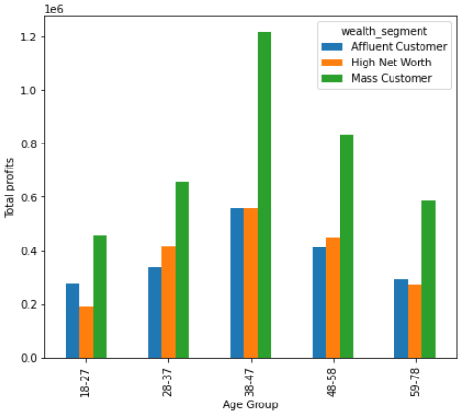
Data Exploration
Profit of wealth segment by age cluster
Overall, the mass customer segmentation makes the highest profit across the different age clusters.
Mass Customers aged between 38-47 are likely to bring more profit for the company to other age clusters.
The next category is the ‘High net worth’ customers.
The Affluent customer can outperform the ‘High net worth’ customers in the 59-78 age group.

Slide 9
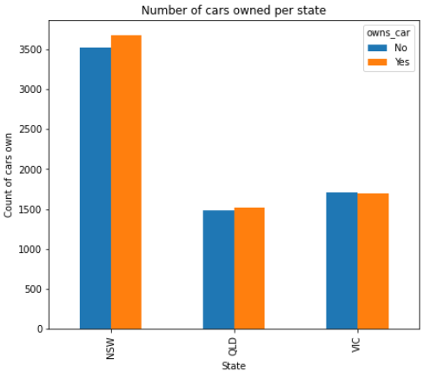
Data Exploration
Number of cars owned in each state.
NSW has the largest amount of people that don’t own a car . NSW seems to have a higher number of people from which data was collected.
Victoria is also split quite evenly . But both numbers are significantly lower than those of NSW.

Slide 10
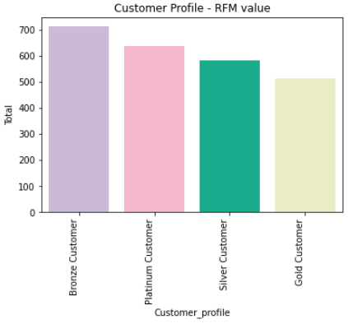
Model Development
RFM analysis and customer segmentation
RFM segmentation model is very insightful to determine which customers business should target to increase its revenue and value.
RFM (Recency, Frequency, Monetary) analysis is a behavior-based approach grouping customers into segments. It groups the customers based on their previous purchase transactions. How recently, how often, and how much did a customer buy.
Most of the customers are in bronze group.

Slide 11
Model Development
Customer segmentation – Targeting high value customers
The high value customers that should be targeted from the new list:
Most of the high customers value are female compared to male.
Targeting the customers that are in financial, health and manufacturing industry sector.
The majority of high value customers are in aged between 40-49.
Most of High value customers lives in NSW and VIC states.

Slide 12
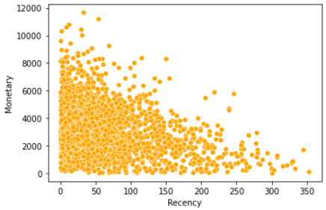
Model Development
RFM analysis Recency against Monetary
The customers who purchased recently have generated more revenue than customers who visited a while ago.
Customers from recent past (50-100 days) also generated a moderate amount of revenue.
Those who purchased more than 20 days ago generate low revenue.

Slide 13
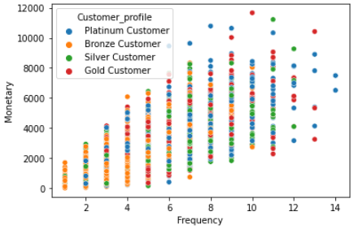
Model Development
RFM analysis Frequency against Monetary
Customers classified as platinum customers visit frequently which correlated with increased revenue for the business.
There is a positive relationship between frequency and monetary gain for the business.

Slide 14
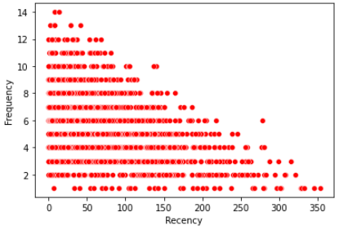
Model Development
RFM analysis Recency against Frequency
Customers that have purchased more recently (0-50 days) have a higher chance of visiting more frequently.
There is a negative relationship between frequency and recency.

Slide 15
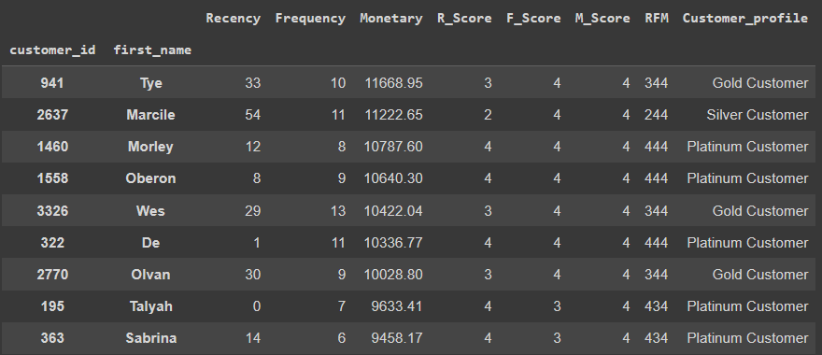
Interpretation
Summary Table For High Value Customers

Slide 16
Thank You

